Slide 1
Perspectives on Canadian Studies III
Prof. Dr. Kathleen Scherf
Thompson Rivers University
at Johannes Gutenberg University
26 June 2015

Slide 2
Welcome back, everyone!
Today’s general agenda:
10:00 to 10:30. Decolonization
10:30 to 11:00. Emma Lee Warrior, “Compatriots”
11:00 to 11:15. Break
11:15 to 11:45. Thomas King, “Dead Dog Café”
11:45 to 12:15. Group work
12:15 to 12:45. Presentations
12:45 to 14:00. Lunch
14:00 to 15:00. Experiential Tourism in Canada
15:00 to 15:15. Break
15:15 to 16:00. Tourism Quiz and Sharing, Throat Singing

Slide 3
Colonial, Post-Colonial, Decolonial
Indigenous Decolonization is a process that Indigenous people whose communities were grossly affected by colonial expansion, genocide and cultural assimilation may go through by recolonizing with other Indigenous frameworks of thought, in understanding the history of their colonization and rediscovering their ancestral traditions and cultural values. There are many ways in which Indigenous artistic production may work to decolonize. We will explore some of those ways this morning.

Slide 4
Professor Darlene Johnston, UBC Faculty of Law. “Respecting and Protecting the Sacred,” 2006.
In Anishnaabeg culture, there is an ongoing relationship between the Dead and the Living; between Ancestors and Descendants. It is the obligation of the Living to ensure that their relatives are buried in the proper manner and in the proper place and to protect them from disturbance or desecration. Failure to perform this duty harms not only the Dead but also the Living. The Dead need to be sheltered and fed, to be visited and feasted. These traditions continue to exhibit powerful continuity.

Slide 5
Decolonization: Reclaiming Indigenous Traditions
This notion of the souls of bones is key to understanding both the reverence with which human remains are treated after death and the abhorrence of grave disturbance which persists among the Anishnaabeg. Many Euro-Canadians miss the redundancy in the expression “sacred Indian burial ground.” How could burial grounds not be sacred if they contain the Body-Souls of one’s ancestors?

Slide 6
Leeanne Simpson
https://www.youtube.com/watch?v=xwxruGeuGt8

Slide 7
Emma Lee Warrior, “Compatriots”
What do you make of this curious story? Round table.
To what do you think the title refers?
What kinds of things do we find out about the Indian characters?
What kinds of things about the white characters?
Are there some outstanding symbols in this story?
How does the mythology compare with the reality?
Is there a theme in this story?
Can you think broadly of some other examples of such themes?

Slide 8
Break time—please return at 11:15.

Slide 9
The Dead Dog Café, Tom King, CBC Radio
https://www.youtube.com/watch?v=UG0wxJeg-cg
https://www.youtube.com/watch?v=5v-lK4c6CS4

Slide 10
Group Work, then a discussion
Break into groups of 3, 3, and 4.
Based on the story “Compatriots”, Leanne Simpson’s spoken word piece about the burial mounds at Rice Lake, and the two episodes of Dead Dog Cafe,” what observations can you draw about the Aboriginal voice and decolonization?
Decide who will give the oral presentation.
Aim for about 5 bullet points, 5 to 10 minutes.

Slide 11
Lunchtime! Please return at 13:00.

Slide 12
Tourism in Canada Our national tourism marketing organization Part of the Canadian Tourism Commission

Slide 13
What does Destination Canada Do?
A Crown corporation wholly owned by the Government of Canada, we report to Parliament through the Minister of Industry, its legislated mandate is to:
Sustain a vibrant and proﬁtable Canadian tourism industry.
Market Canada as a desirable tourism destination.
Support a cooperative relationship between the private sector and the governments of Canada, the provinces and the territories with respect to Canadian tourism.
Provide information about Canadian tourism to the private sector and to the governments of Canada, the provinces and the territories.

Slide 14
How important is tourism for Canada? Very!
Latest statistics for March 2014: Canada had 851,385 overnight visitors, up 7.8% from March 2013.
Germany was in 6th place, with 14,712 visitors, up 5.5% from March 2013 (Ontario, BC, Alberta mostly).
For 2014 overall, Canada had 18 million international overnight visitors.
These international visitors spent $15 billion.
The tourism industry creates 619,000 jobs.
All tourism revenues total $84 billion.

Slide 15
A brand distinguishes and characterizes a product, service, concept.

Slide 16
Experiential vs. Attraction Tourism

Slide 17
Some Canadian Examples
http://en.destinationcanada.com/resources-industry/toolkits/eq-teaser
http://www.gmist.ca
https://www.youtube.com/watch?v=zWkVzR3r5_w
The Thompson-Okanagan Tourism Authority’s strategy is rooted in five experience-based themes:
• Enriching local flavors
• Identifying the iconic
• Revealing the story
• Expanding personal horizons
• Building authenticity

Slide 18
Your last break! See you at 15:15!

Slide 19
Canada—You would love it!
https://www.youtube.com/watch?v=cotGh4Lu29M

Slide 20
Finally, it’s time for a quiz…. What kind of tourist are you?
http://quiz.canada.travel

Slide 21
Tanya Tagaq, Innuit Throat Singer
https://www.youtube.com/watch?v=FcOYx4_72Zo

Slide 22
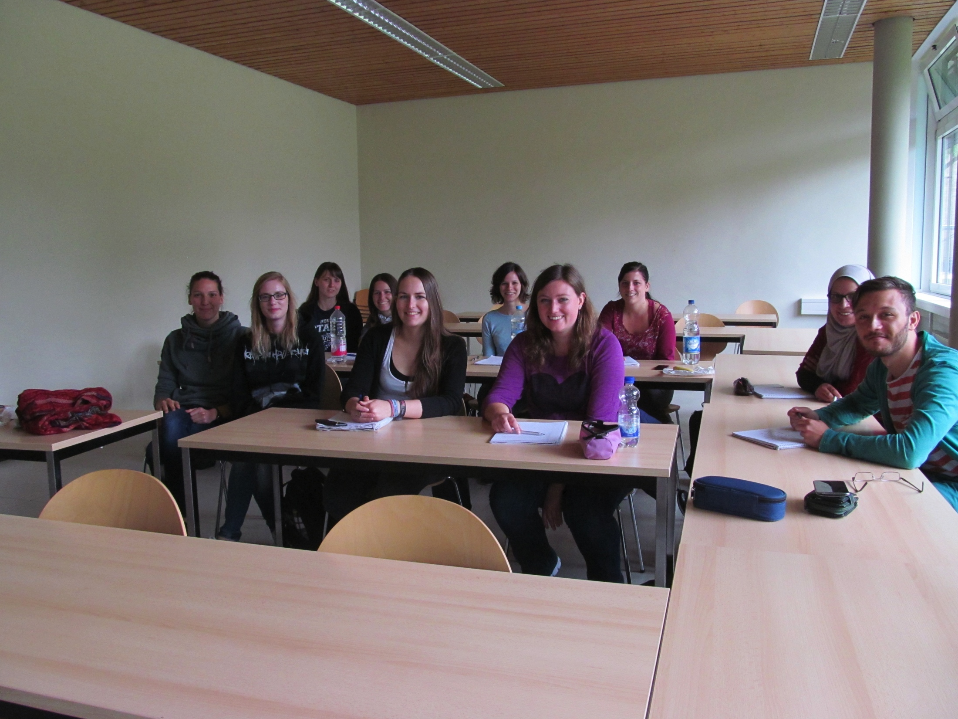
Ten totally awesome people are in this picture….
Thank you so much! What a pleasure this has been for me. See you tomorrow at 10:15!

